Slide 1
Pressure Dependence on the Bethe Slater Curve
Jacky Lao

Slide 2
Contents
Data
Fitting to data
Polynomial Fits
Nonparametric smoother
Rose Model
Pressure Dependence with Rose Model
Exchange as a function of D, d

Slide 3
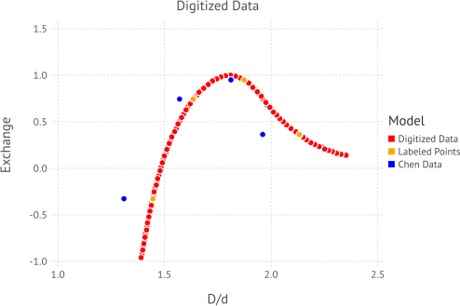
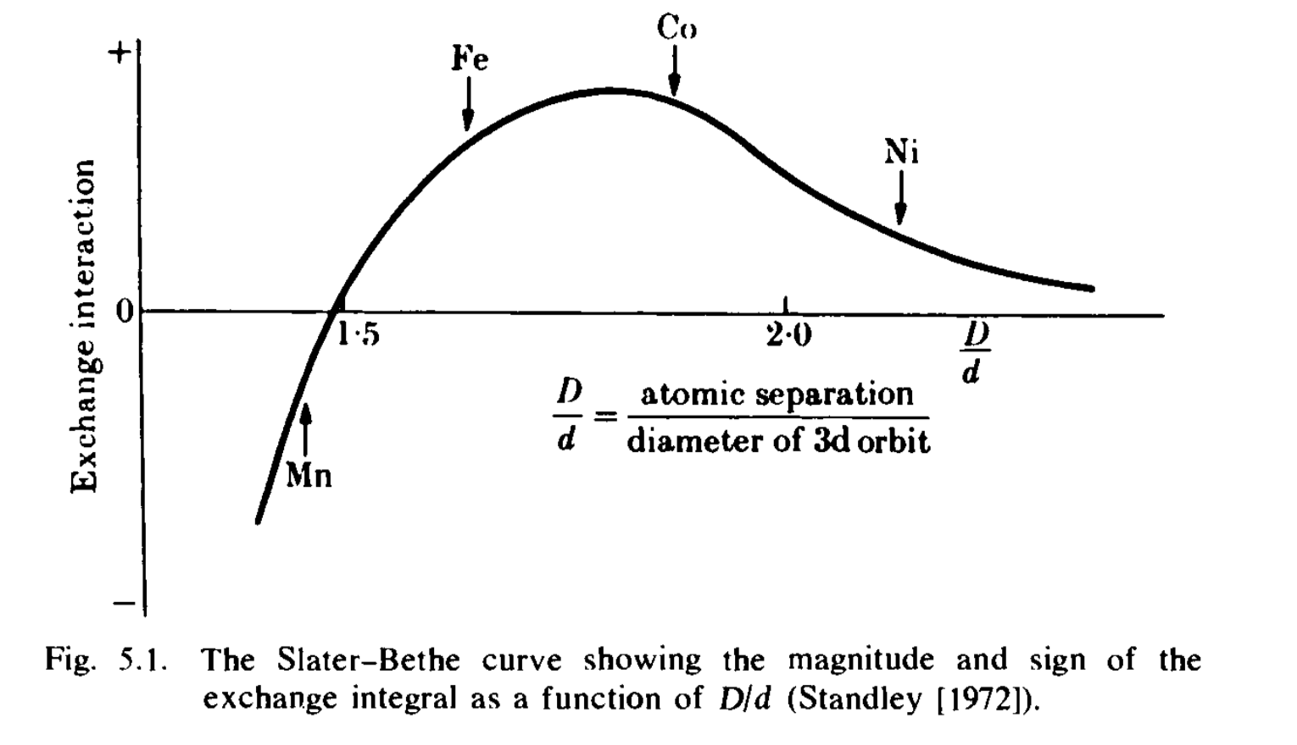
Data
Gallagher et al. 1999

Slide 4
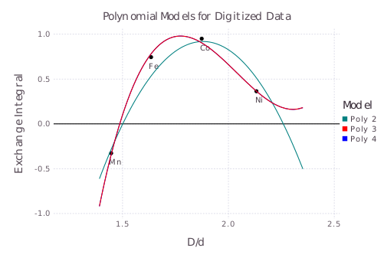
Polynomial Fits
3rd and 4th order polynomials are nearly the same
2nd order fit is lacking

Slide 5
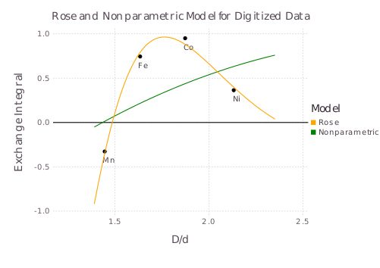
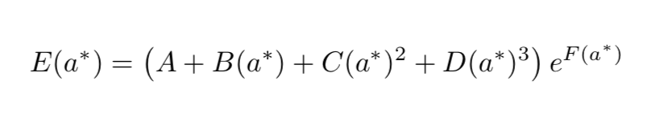
NP and Rose model fits
Nonparametric fit is just terrible
Rose model is quite reasonable

Slide 6
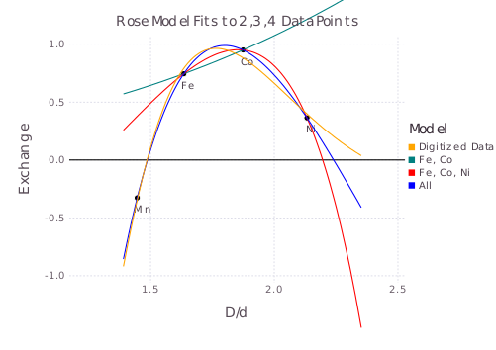
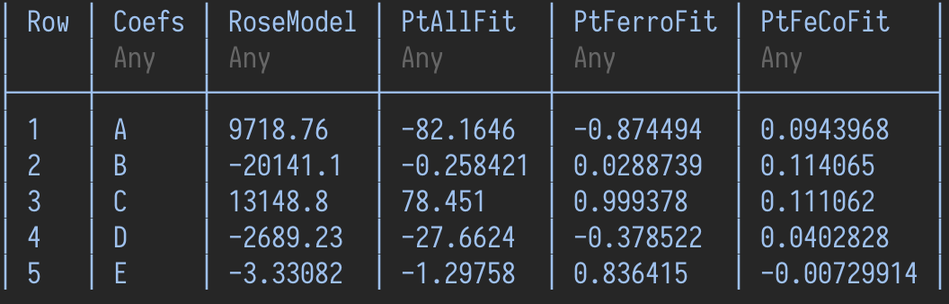
Rose Model to labeled data
Attempted to fit the Rose model to the labeled points
Can perfectly fit all four labeled points

Slide 7
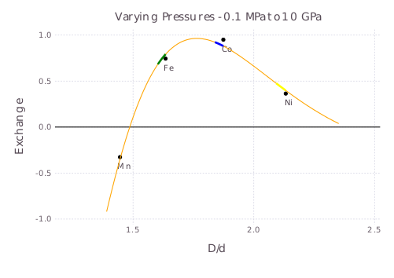
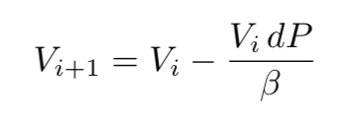
Pressure Dependence
Change in volume calculated with the following bulk moduli
Fe - 170 GPa
Co - 180 GPa
Ni - 180 GPa

Slide 8
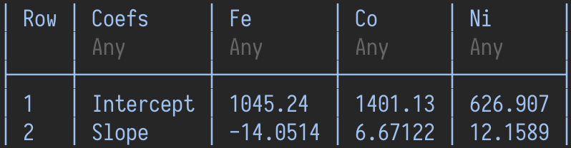
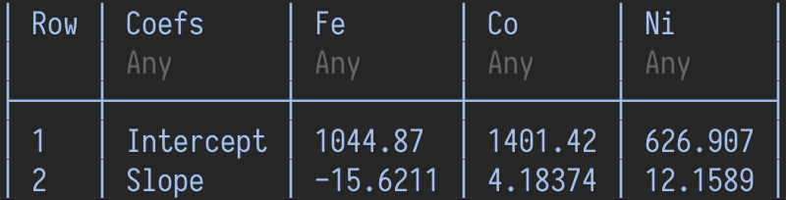
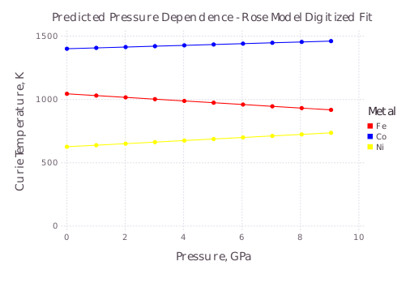
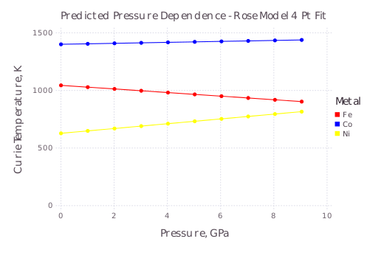
Temperature Results

Slide 9
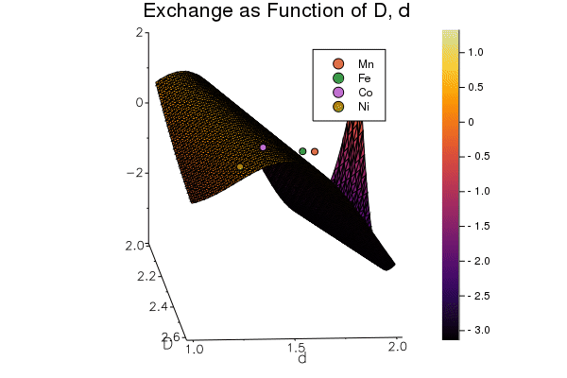
Exchange as Function of D,d

Slide 10
Conclusions
Arguably got better fits than Eli
Unsure whether he pinned the exponent coefficient in the Rose model
Prediction of Curie Temperature’s dependence on Pressure assumes constant 3d orbital diameter
Restrictive assumption that is unlikely in reality
Modeling the 2d surface of D and d is difficult without more data.
https://github.com/selwyni/Magnetic445

